Slide 1
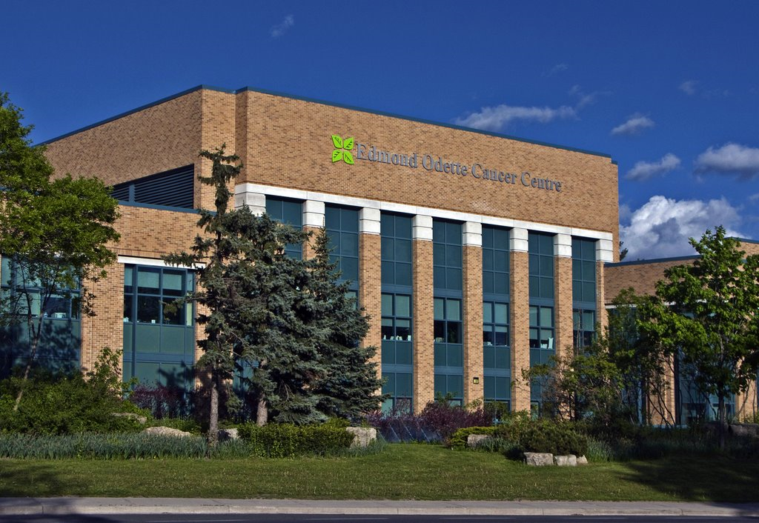
Towards Personalized Brachytherapy at the Odette Cancer Centre
Ananth Ravi, PhD, MCCPM

Slide 2
Brachytherapy Activity @ OCC 2012
Notes:
375 patients last year for a total of 780 treatments.

Slide 3
Brachytherapy Activity @ OCC 2012
Notes:
select these two site to discuss some of the development we are doing at the OCC.
For Endometrial cancers, we are trying to develop a more patient specific application of brachytherapy.

Slide 4
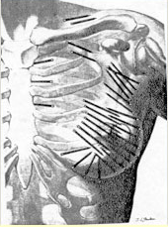
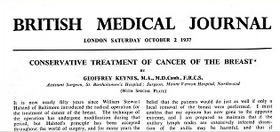
Permanent Breast Seed Implantation

Slide 5
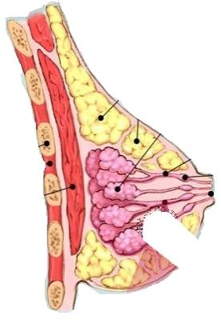
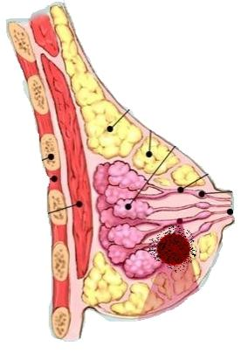
Accelerated Partial Breast Irradiation
Early stage → 6% local recurrence @ 5 years
76-90% recurrences in the surgical cavity
Dramatic reduction treated volume
reduction of side effects
hypofractionation

Slide 6
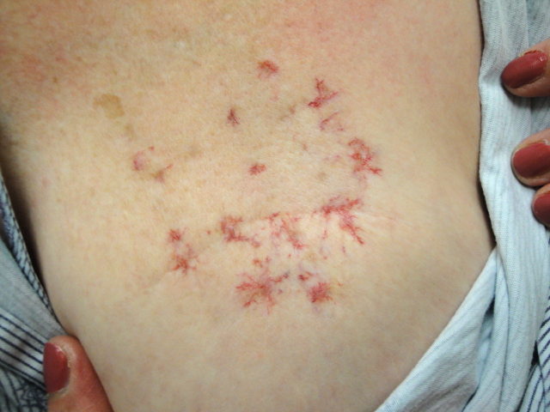
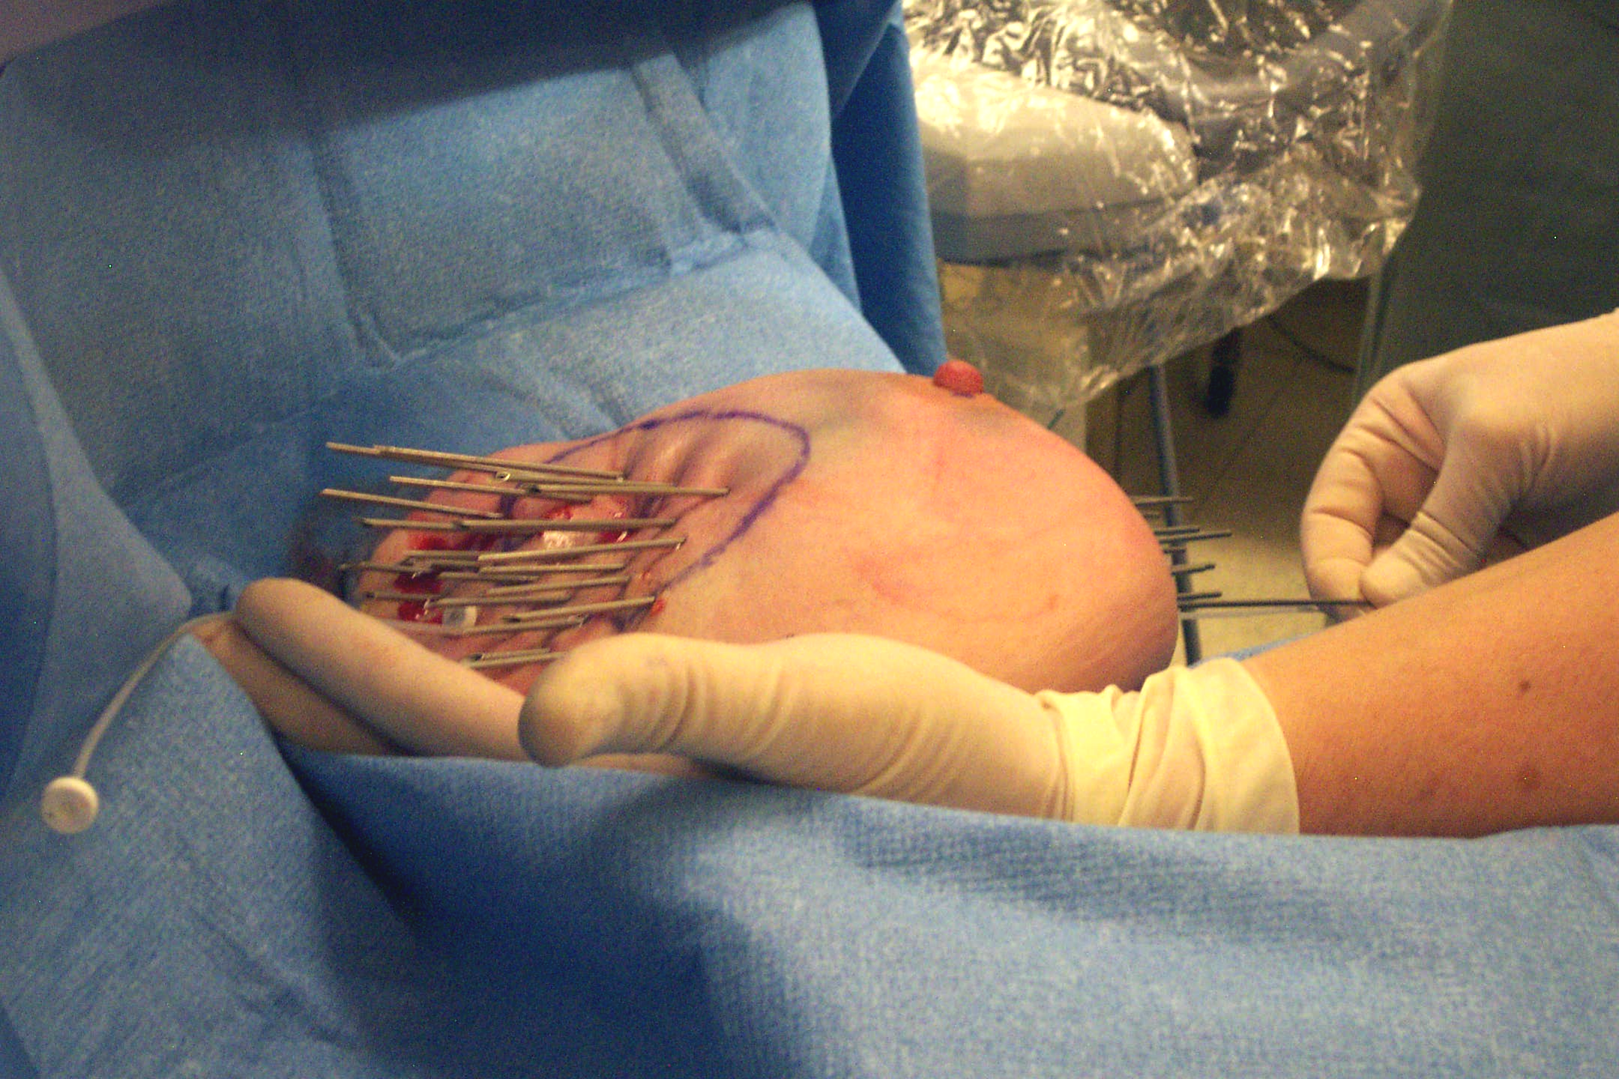
HDR interstitial Experience
34 Gy in 10 fractions BID
Telangiectasia correlated with treatment area
Lack of adequate Q/A, moving target

Slide 7
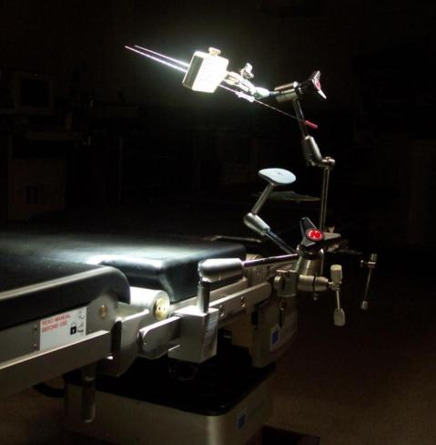
Interstitial Permanent LDR Breast Brachytherapy
80-90 ¹⁰³Pd brachytherapy sources
1 hour procedure
90 Gy to 1.5 cm margin around surgical cavity
Light sedation w/ local anesthetic

Slide 8
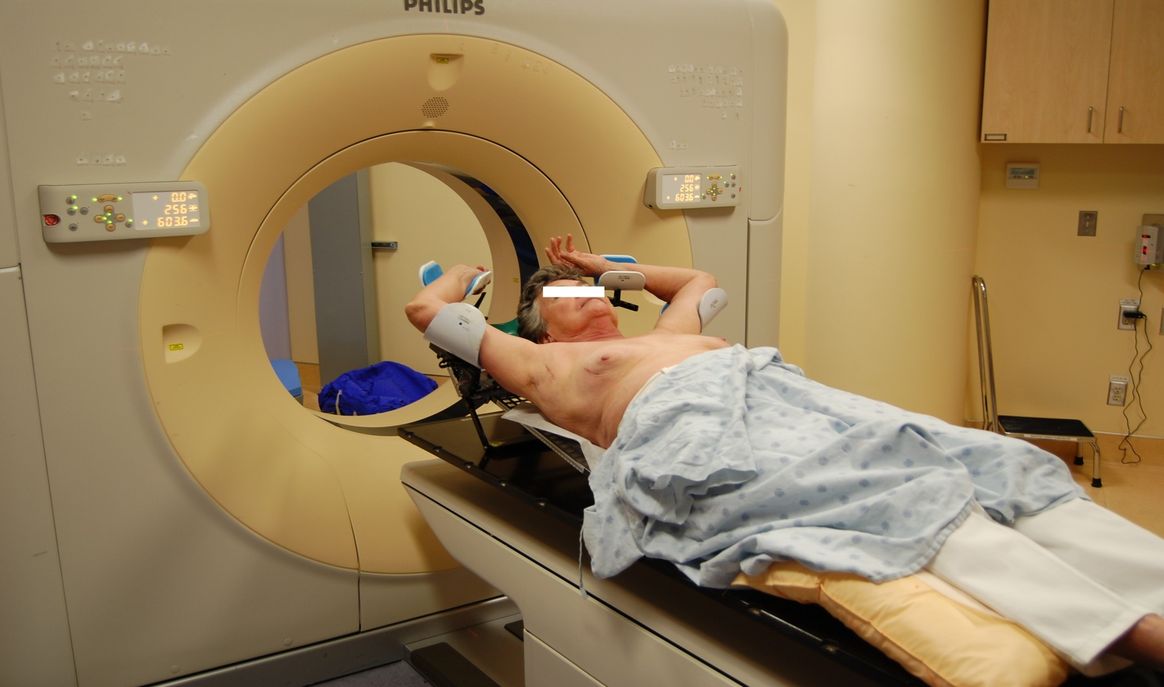
CT simulation

Slide 9
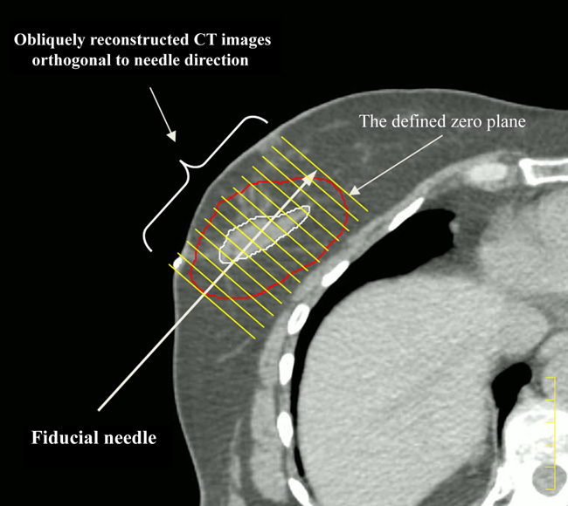
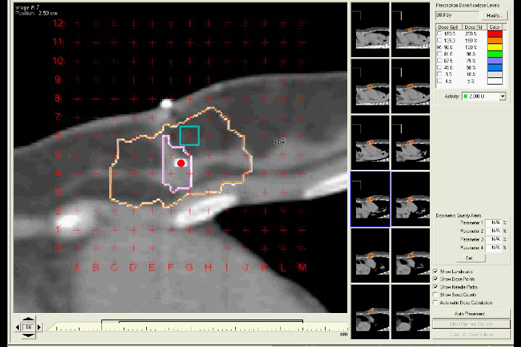
Pre-implant treatment planning

Slide 10
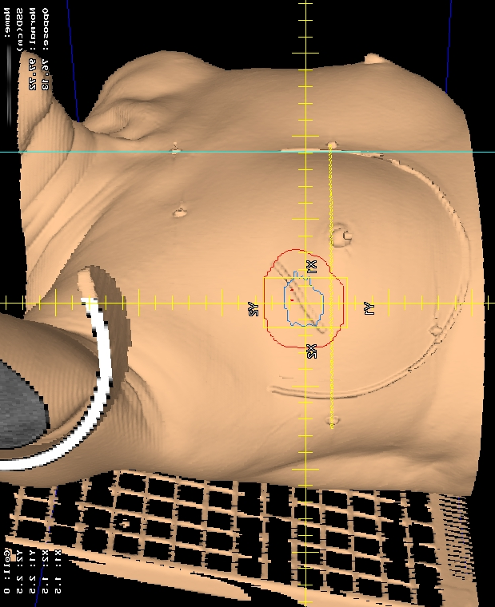
PBSI patient setup
Operating Room setup
3D rendering

Slide 11
Implantation Procedure
fiducial
needle
Surgical
cavity

Slide 12
Post-implant QA
Post-implant 2D radiograph
2 Month Post-implant QA

Slide 13


Radiation safety of ¹⁰³Pd
Detector
at 1 m
Skin
d
r
?
?
R
?
?
PTV
Average 0.97 ± 1.0 mSv.
Keller B et al. Int. J. Rad. Oncol. Biol. Phys. 62:2:358, 2005
Notes:
Keller et al. in the early days of PBSI evaluated Pd and I-125 for their radiation safety, and developed a formalism that takes into account the volume of the PTV, its depth, the effect of dose and radionuclide physical parameters like half-life and energy.
The NCRP suggests a limit of 5 mSv for care givers/spouse who receive exposure from radionuclide therapy patients.
Using this formalism Keller et al. were able to determine that Pd-103 was constantly below 2.6 mSv
Using this formalism and adapting it I wanted to determine if Cs131 was going to be safe.

Slide 14
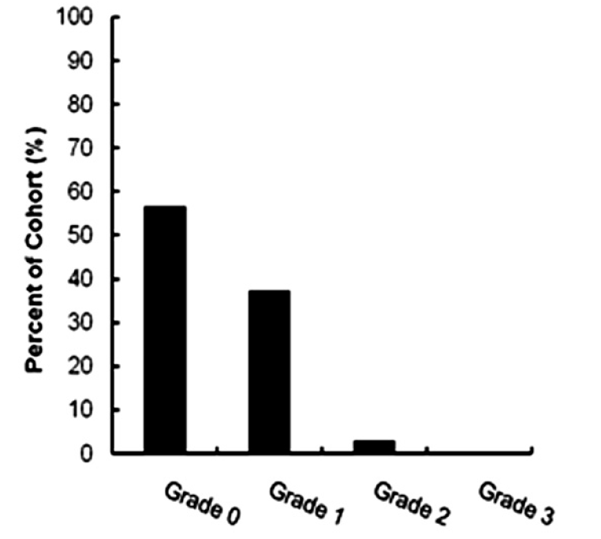
Quality of Life
Satisfaction
RTOG 95-17 criteria
Skin toxicity @ 6 months
98% satisfied
Keller, Ravi, et al., IJROBP 83.1 (2012): 84-92.

Slide 15
Outcomes
N = 115
5 years Overall Survival 97.3%
Median follow-up 62 months [0 – 98 months]
2 deaths of other causes
1 regional relapse (6.5 years)
1 patient with metastatic disease
3 ipsilateral breast recurrence (5.5 and 6.5 years)
4 contralateral tumors (2 DCIS, 1 IDC and 1 LABC)
97.3%

Slide 16
Permanent Breast Seed Implantation
PBSI is an effective APBI treatment for early stage breast cancer patients, offering a better quality of life during treatment
Notes:
I have shown that we can localize the seeds after 30 seconds of imaging with a maximum error of just 1.7 mm.
I have demonstrated for the first time that a gamma-camera can meet both the imaging time and resolution design criteria for guidance of PBSI procedures.

Slide 17
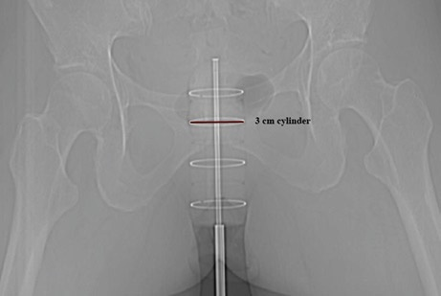
Endometrial Cancer

Slide 18
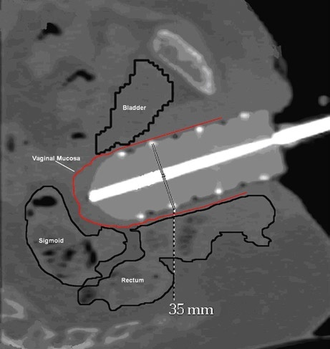
Vaginal Vault Brachytherapy
Adjuvant setting
+^{ve} node → brachy + XRT
-^{ve} nodes → brachy alone
Recurrent setting
No prev XRT→ brachy +XRT
Prev XRT → brachy alone
Top 3-4 cm at 0.5 cm
5.5 – 7 Gy x 2-3 fx

Slide 19
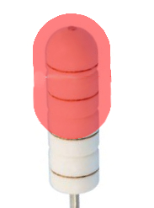
Geometric Assumption
Vault shape geometry →clinical exam
Vault tissue conforms to cylinder
Disease is at a uniform depth → ~0.5 cm

Slide 20
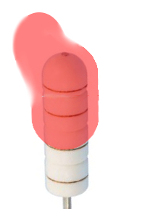
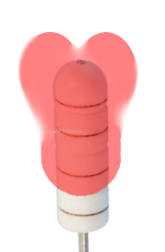
Problematic cases
Asymmetric vaults
Dog-eared vaults
Fibrosis, scarring, unresolved hematomas
Anterior or total pelvic exenterative surgery

Slide 21
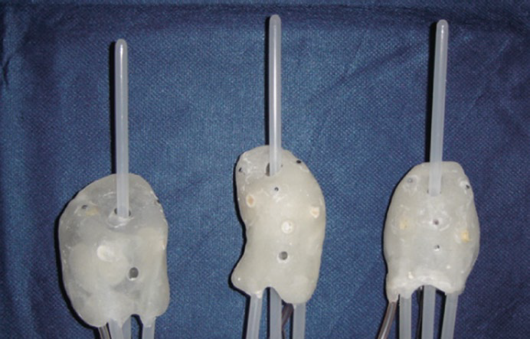
French “moulage” technique
Institut Gustave-Roussy
liquid paste → solidifies to create vaginal impression
Impression then converted to acrylic applicator
Albano et al, Cancer Radiotherapie 12:822-826, 2008

Slide 22
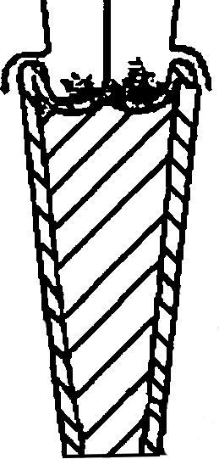
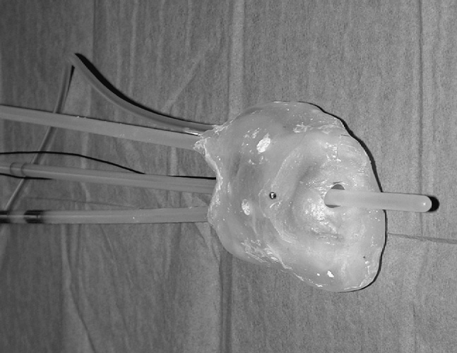
Issues with “moulage” technique
Vaginal cuff/intact cervix expands larger than introitus
Surgical extraction
Risk mitigated with gauze
Only straight catheter paths are possible
gauze
Albano et al, Cancer Radiotherapie 12:822-826, 2008

Slide 23
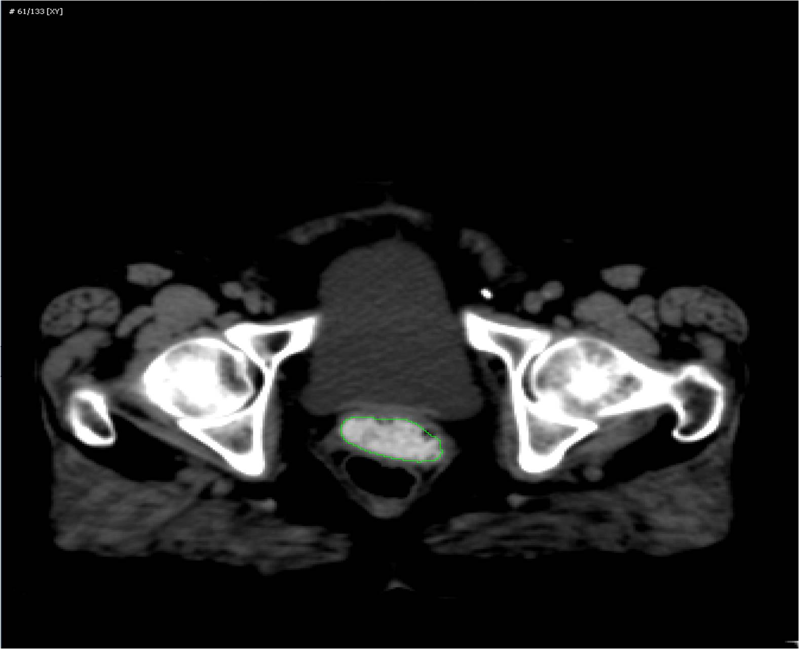
1. Image patient’s anatomy
Wiebe, Ravi et al, IJROBP, 84(3):S870, 2012

Slide 24
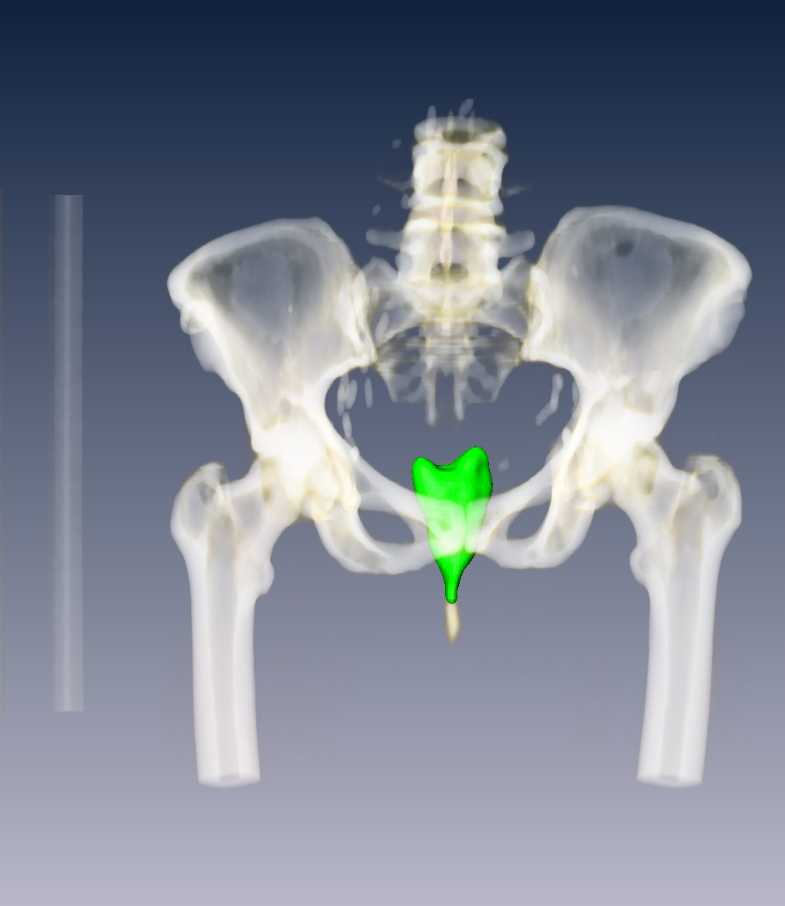
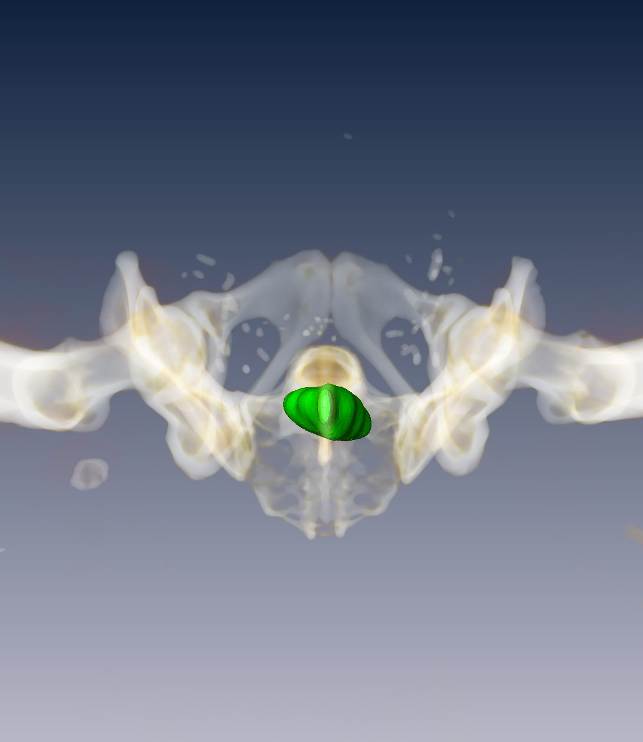
2. Digital model of patient’s anatomy

Slide 25
3. Applicator design

Slide 26
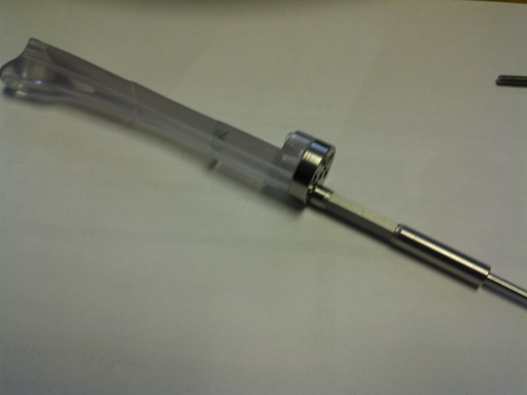
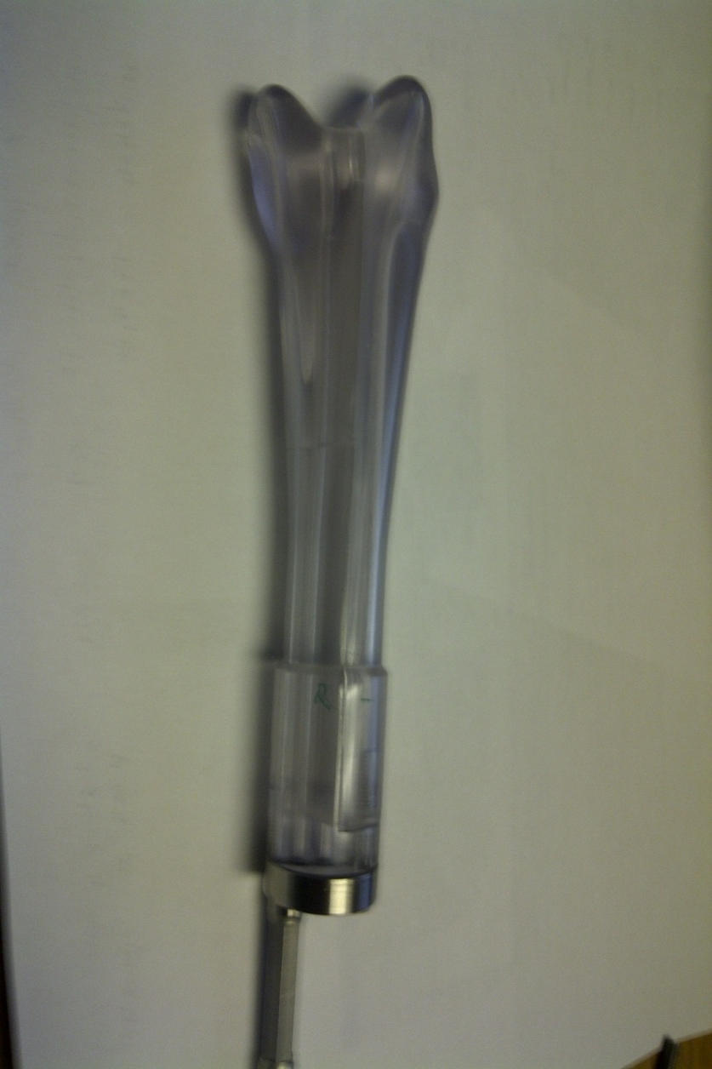
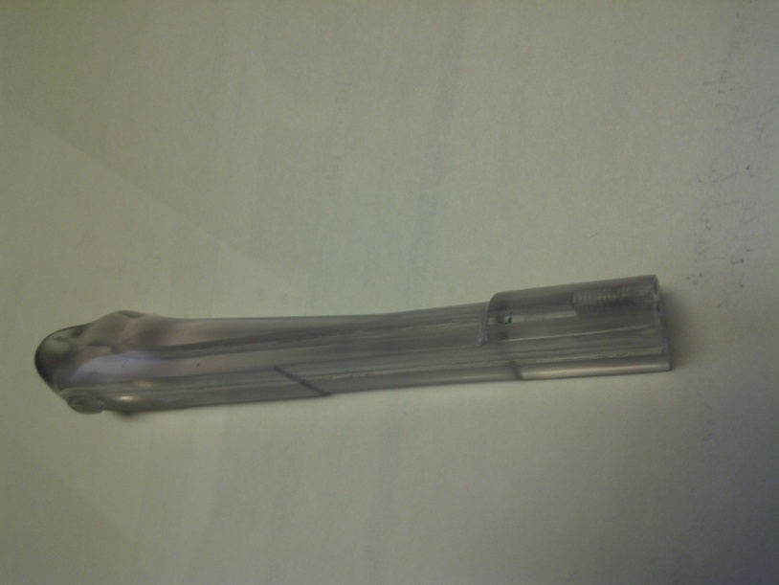
4. Stereolithographically print applicator

Slide 27
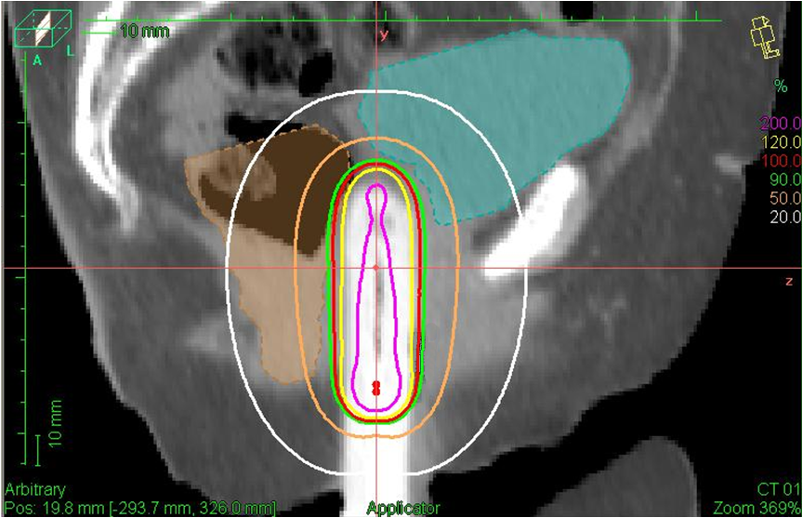
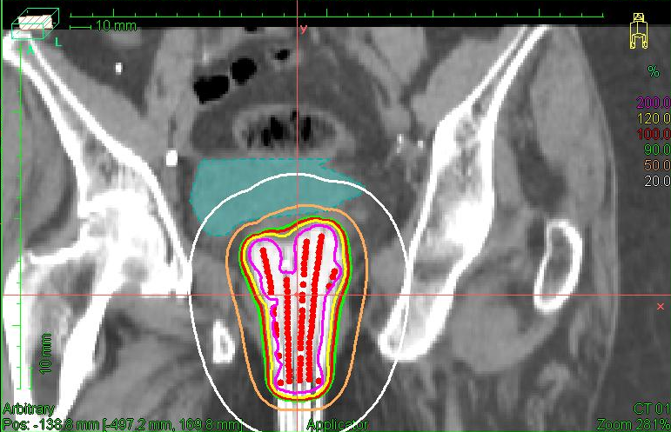
5. Patient specific applicator + patient specific treatment plan
IPSA → 100% to 5 mm depth
Sparing in Ant/Post direction = 2.5 cm cylinder
Notes:
Same sparing as a 2.5 cm cylinder in the ant post direction.
However dramatic loss decrease in dosimetric coverage of

Slide 28
5. Patient specific applicator + patient specific treatment plan
Coverage using 2.5 cm cylinder reduces by 55%
Notes:
Same sparing as a 2.5 cm cylinder in the ant post direction.
However dramatic loss decrease in dosimetric coverage of

Slide 29
Customized vaginal vault brachytherapy
We can now deliver customized vaginal vault therapy to patients who would have otherwise been treated
sub-optimally

Slide 30
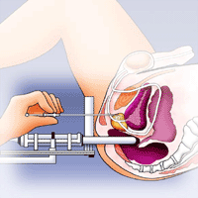
Prostate

Slide 31
Efficacy of HDR for intermediate stage prostate Ca.
HDR + EBRT vs. 86.4 Gy IMRT
Notes:
HDR is effective zelefsky et al.

Slide 32
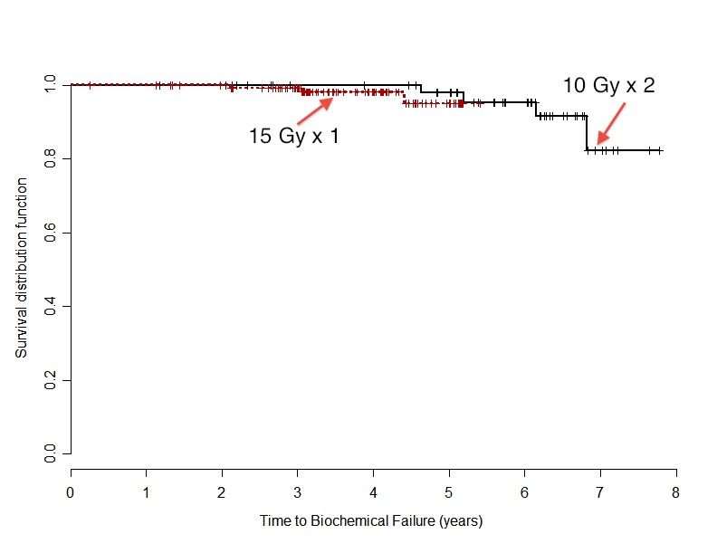
Experience with single fraction
G. Morton et al. Radiotherapy and Oncology 100 (2011) 463–467
 | 15 Gy/1fx HDR 37.5/15fx XRT | 20 Gy/2fx HDR 45.0/25fx XRT
2 yr biopsy +^{ve} rates | 4% | 8%
5 yr biochemical disease free survival | 95.1% | 97.9%
Notes:
Acute GU Toxicity Less with single fraction, p 0.0126
Late Toxicity No difference
Health Related QOL No difference

Slide 33
CT vs. US comparison
CT Technique
Catheter Insertion
CT
Contouring
Catheters
Treatment
Removal
Planning
QA
Adjust
Adjust
6 hours
US Technique
Catheter Insertion
Digitize
Catheters
Treatment
Removal
US
Planning
90 minutes
Courtesy of G. Morton

Slide 34
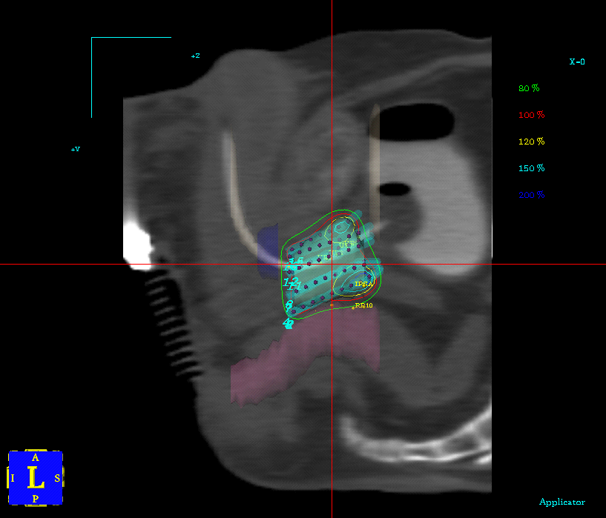
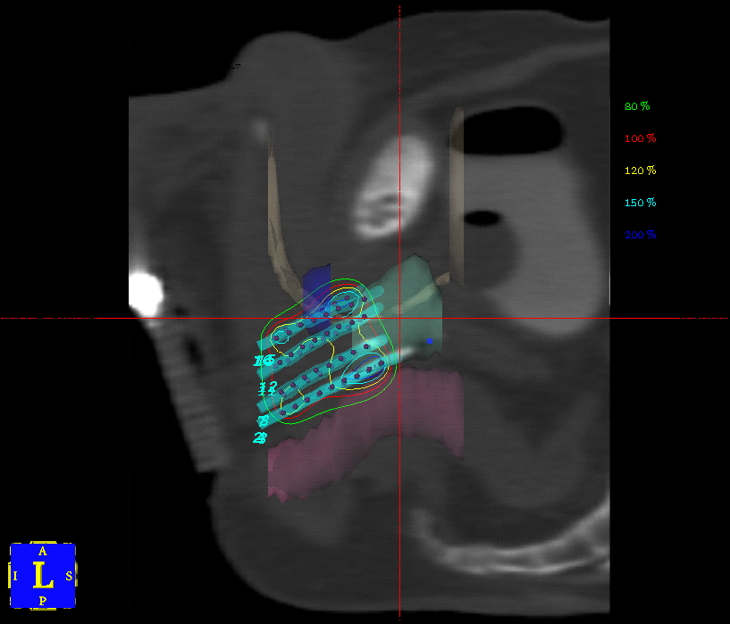
CT-Based Technique and Catheter Displacement
Planned
Delivered
Courtesy of G. Morton

Slide 35
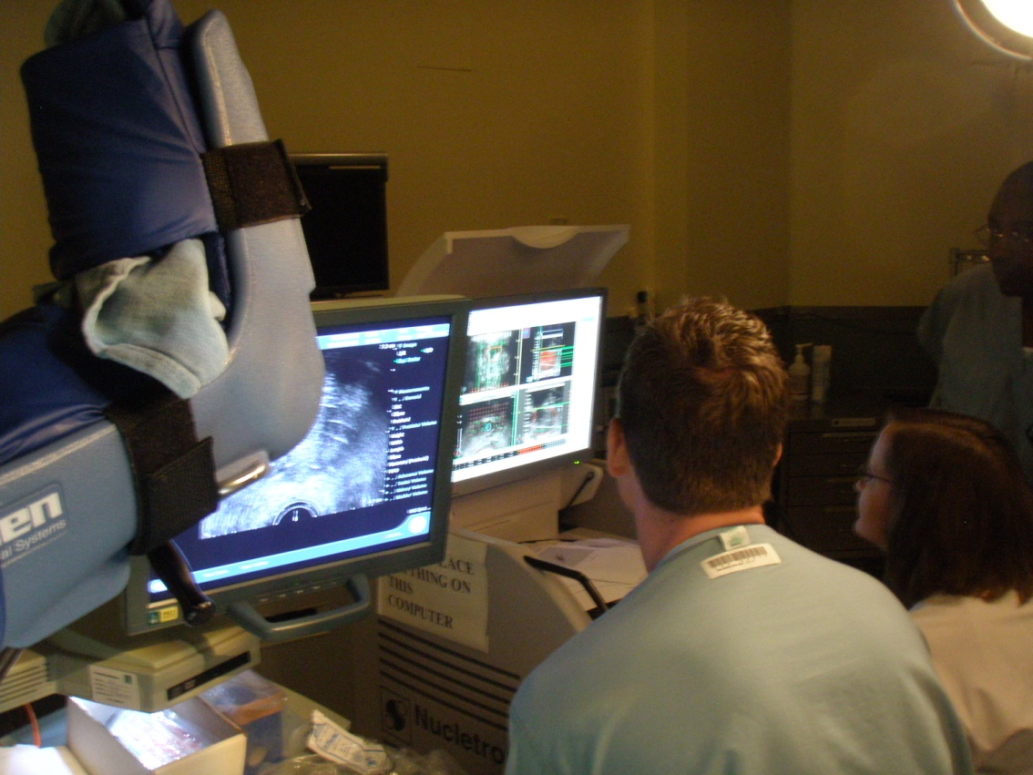
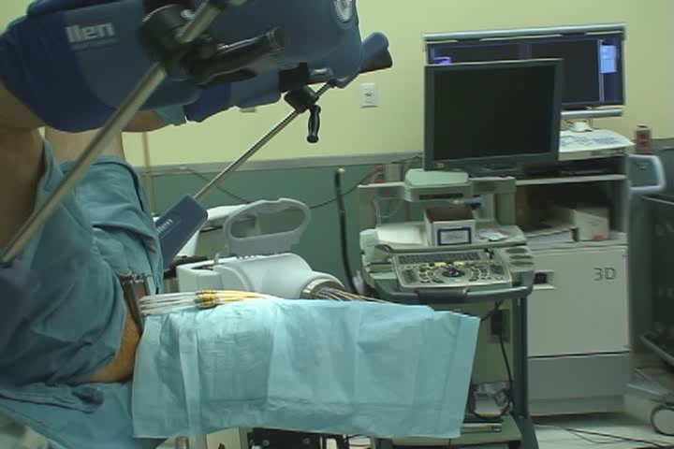
Intra-Operative 3D US Based Planning
Catheter Insertion and Treatment Delivery Without Moving Patient
Minimal Catheter Displacement: treat what we plan
Median shift 0.7 mm with US vs. 10.5 mm with CT

Slide 36
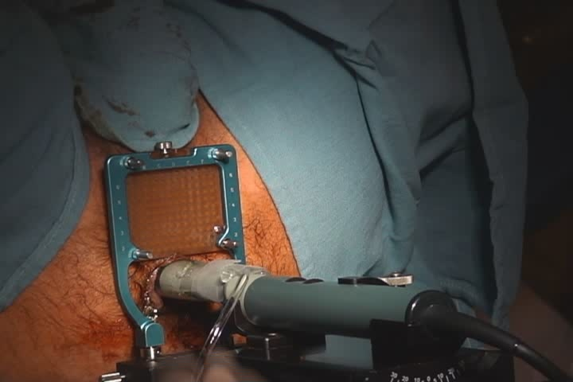
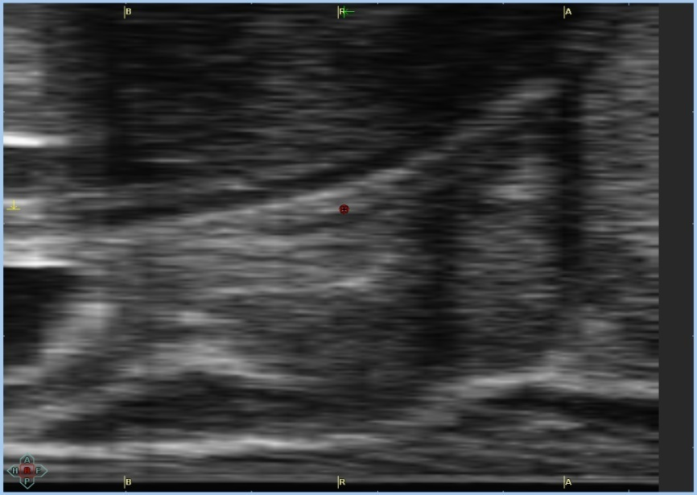
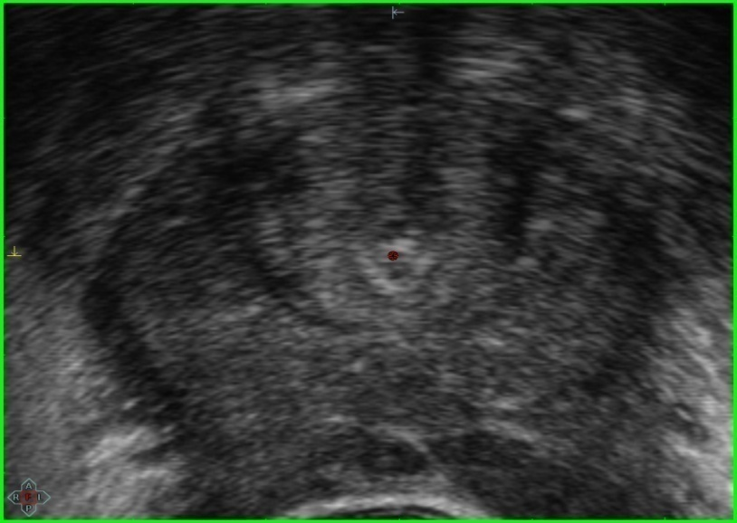
1. Image Acquisition
Image acquisition
Prostate& rectum contouring
Urethra contouring
Catheter Implantation
Re-image and re-contour
Catheter delineation
Optimization
Treatment

Slide 37
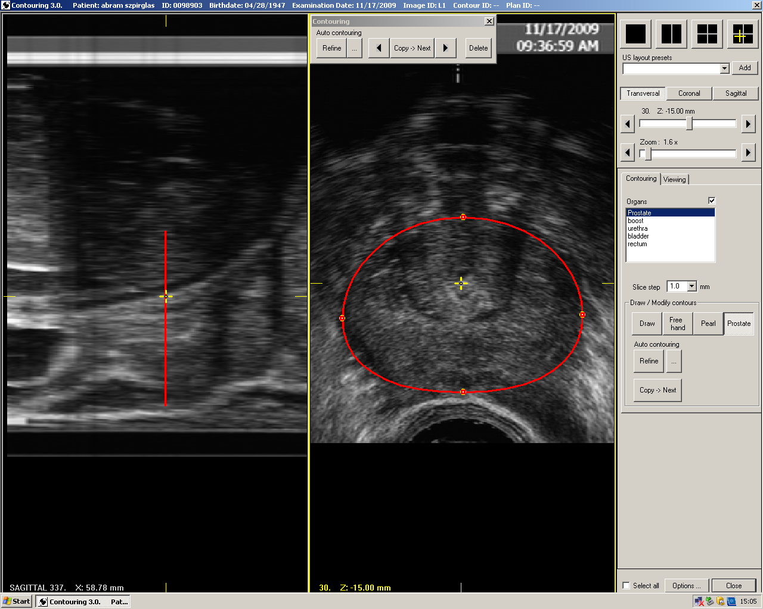
2. Prostate Contouring
Image acquisition
Prostate& rectum contouring
Urethra contouring
Catheter Implantation
Re-image and re-contour
Catheter delineation
Optimization
Treatment

Slide 38
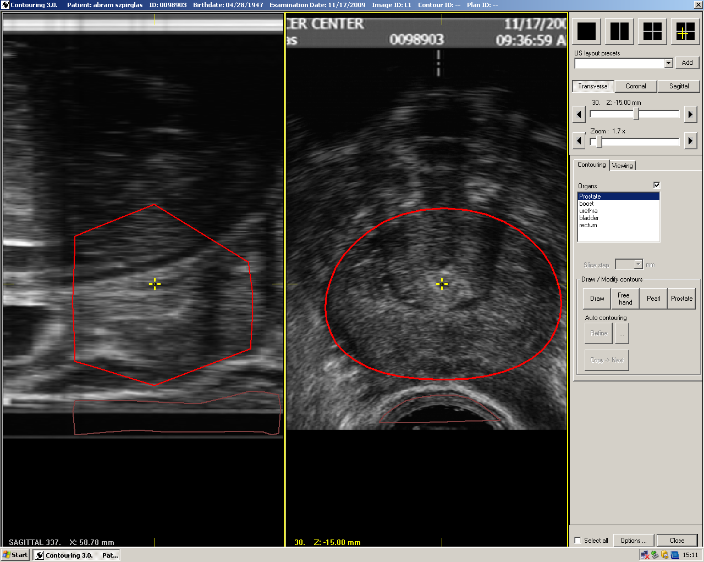
2. Prostate Contouring
Image acquisition
Prostate& rectum contouring
Urethra contouring
Catheter Implantation
Re-image and re-contour
Catheter delineation
Optimization
Treatment

Slide 39
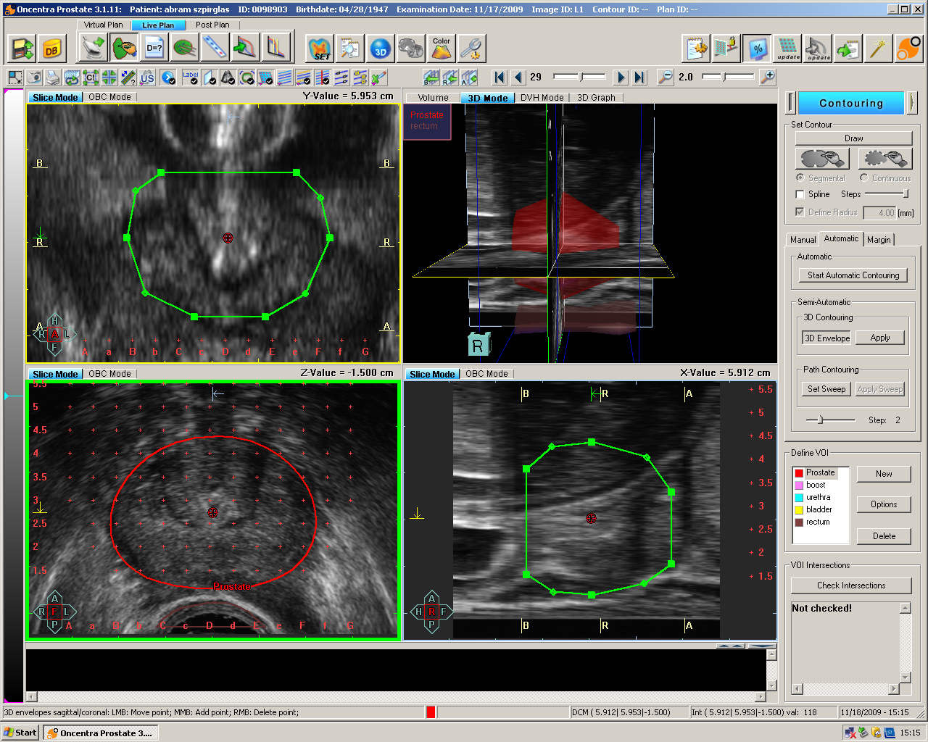
2. Prostate Contouring
Image acquisition
Prostate& rectum contouring
Urethra contouring
Catheter Implantation
Re-image and re-contour
Catheter delineation
Optimization
Treatment

Slide 40
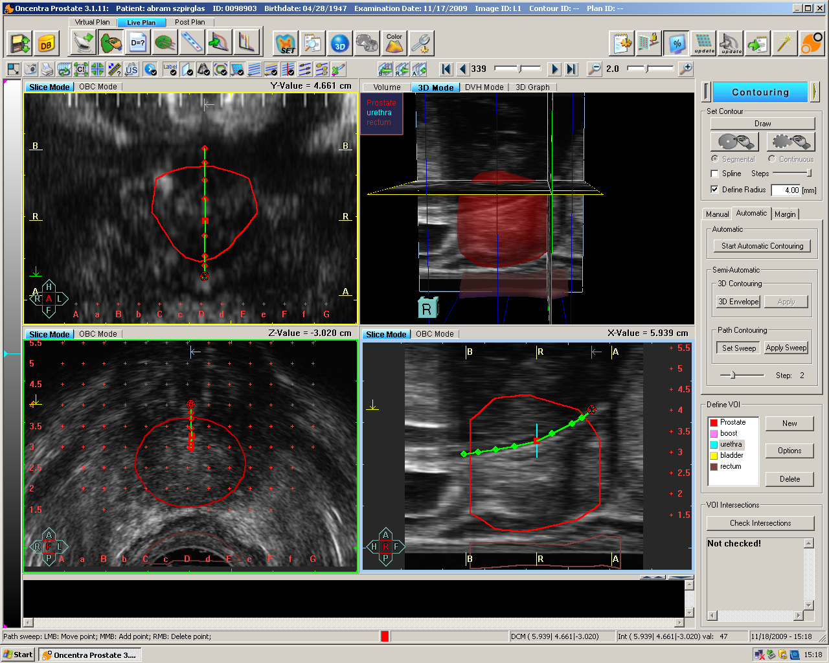
3. Urethra Contouring
Image acquisition
Prostate& rectum contouring
Urethra contouring
Catheter Implantation
Re-image and re-contour
Catheter delineation
Optimization
Treatment

Slide 41
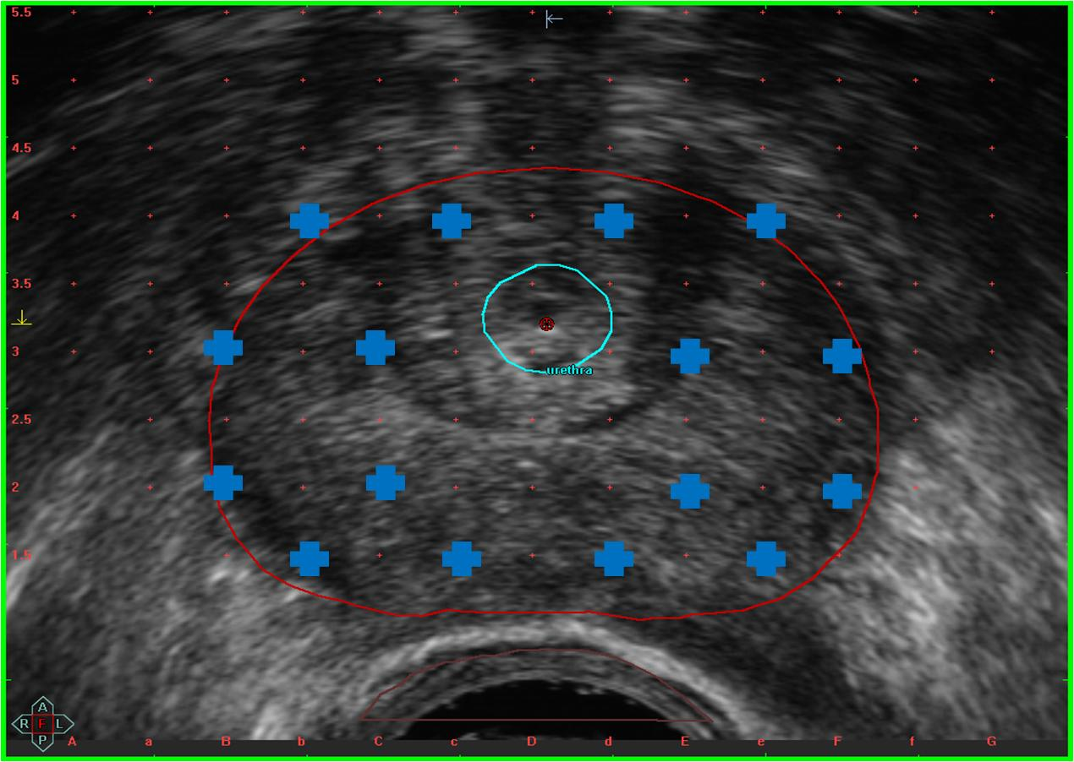
4. Catheter Implantation
Image acquisition
Prostate& rectum contouring
Urethra contouring
Catheter Implantation
Re-image and re-contour
Catheter delineation
Optimization
Treatment

Slide 42
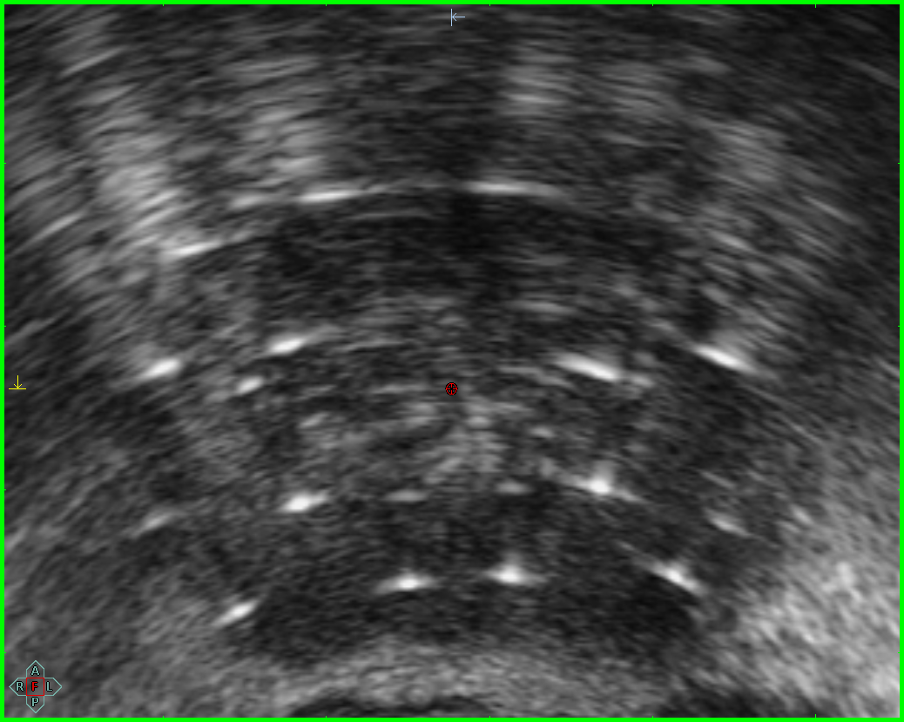
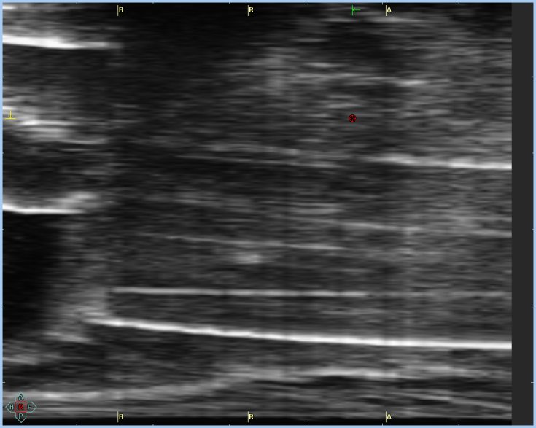
Step 5: Re-Image and Re-contour
Image acquisition
Prostate& rectum contouring
Urethra contouring
Catheter Implantation
Re-image and re-contour
Catheter delineation
Optimization
Treatment

Slide 43
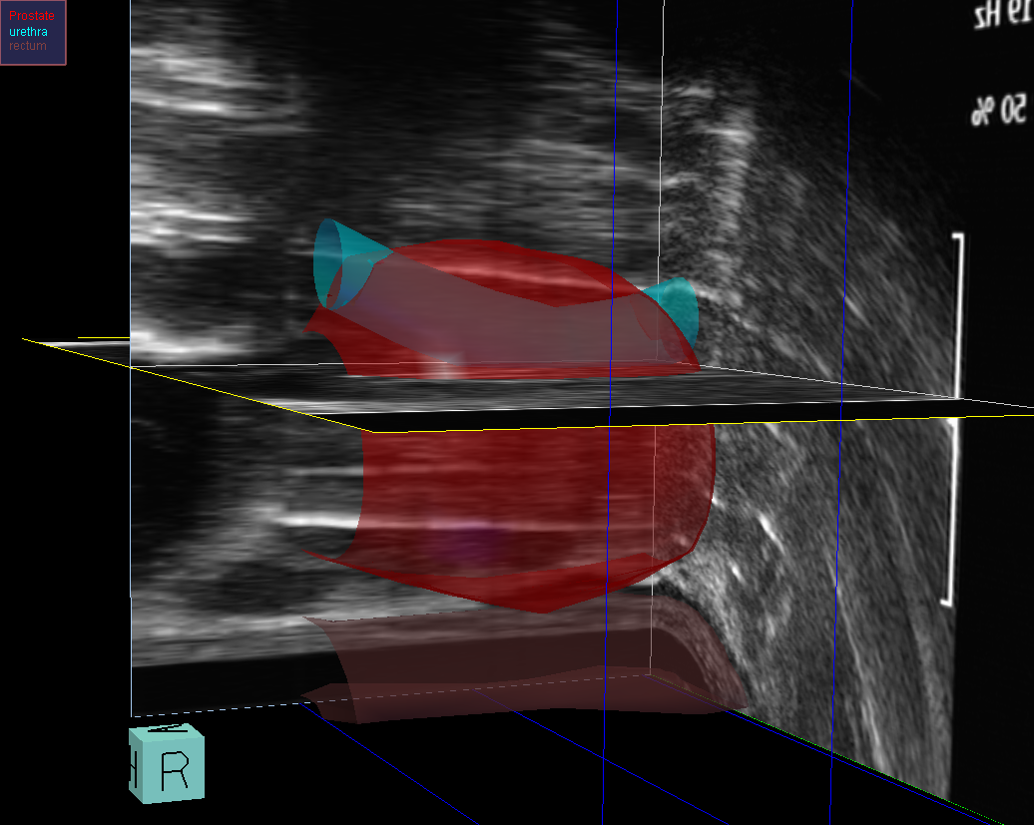
Step 5: Re-Image and Re-contour
Image acquisition
Prostate& rectum contouring
Urethra contouring
Catheter Implantation
Re-image and re-contour
Catheter delineation
Optimization
Treatment

Slide 44
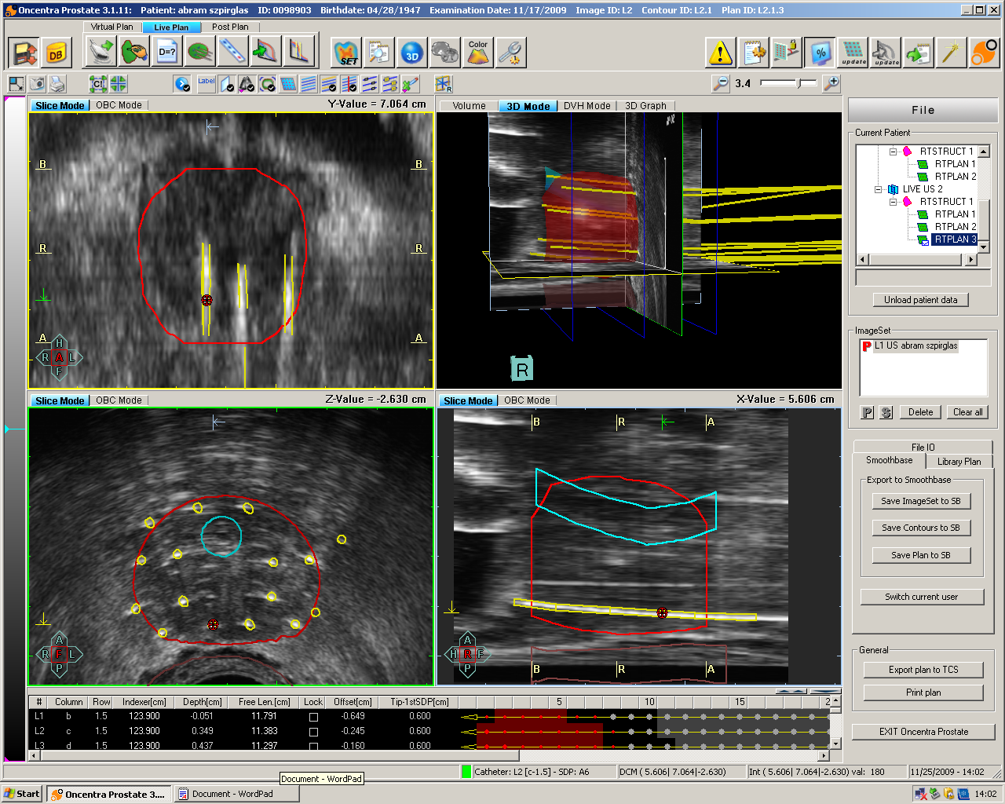
Step 6: Catheter Delineation
Image acquisition
Prostate& rectum contouring
Urethra contouring
Catheter Implantation
Re-image and re-contour
Catheter delineation
Optimization
Treatment

Slide 45
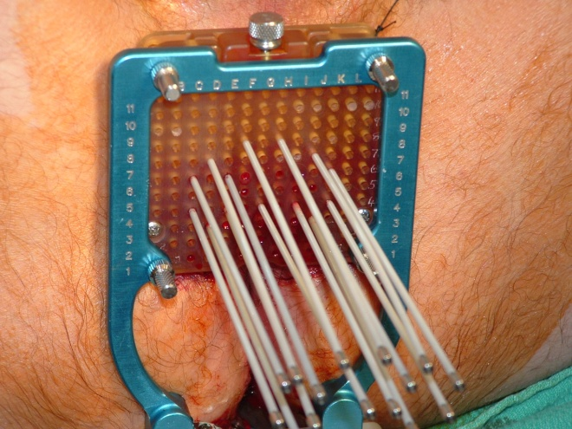
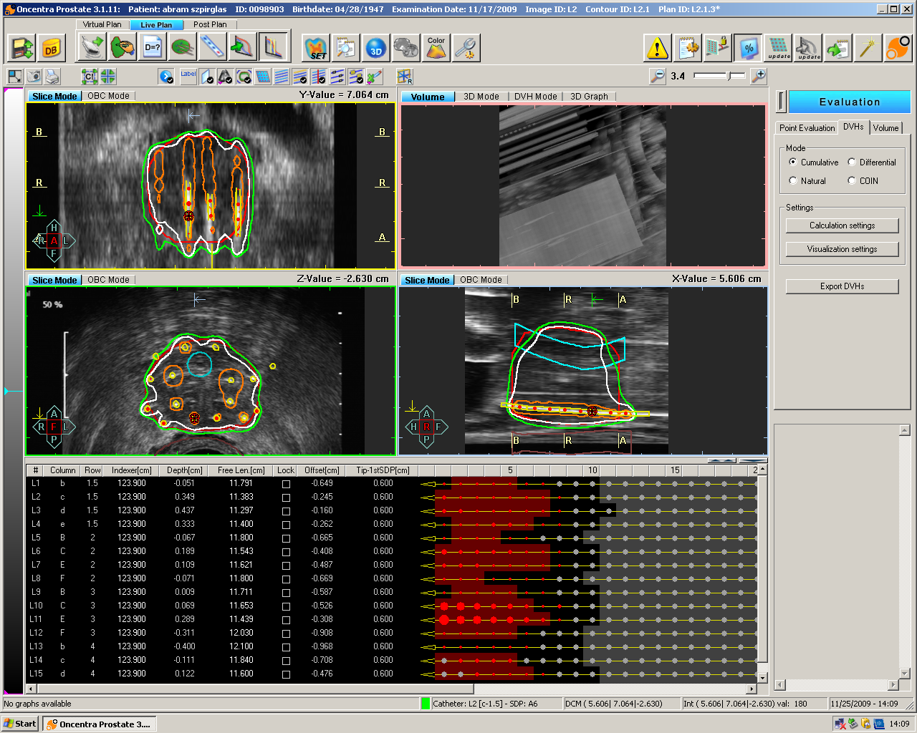
Step 6: Catheter Delineation
Image acquisition
Prostate& rectum contouring
Urethra contouring
Catheter Implantation
Re-image and re-contour
Catheter delineation
Optimization
Treatment
Measurement of Free Length as double check on reconstruction.
Usually get within 1-2 mm

Slide 46
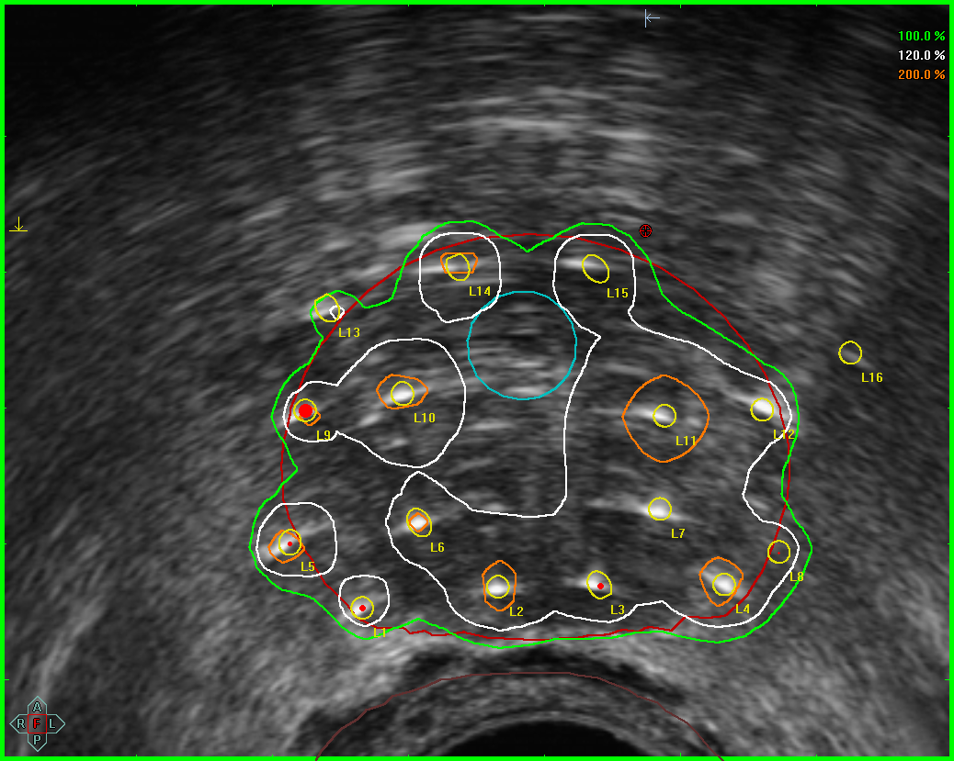


Step 7:Optimization
Image acquisition
Prostate& rectum contouring
Urethra contouring
Catheter Implantation
Re-image and re-contour
Catheter delineation
Optimization
Treatment
V100: 97%
100%
120%
200%

Slide 47

Step 8: Treatment
Image acquisition
Prostate& rectum contouring
Urethra contouring
Catheter Implantation
Re-image and re-contour
Catheter delineation
Optimization
Treatment

Slide 48
Evolution of prostate HDR
US guided Prostate HDR
Intra-prostatic boost
Prostate salvage
Monotherapy
MR → US
fusion
Catheter
Digitization
Dose

Slide 49


Delineating intraprostatic nodules
Load MR and US data
Mask data based on prostate contours
Automatic Rigid registration
Deformable Registration
DICOM export to TPS
US
Intraprostatic
nodule
MR
Venugopal, Ravi, etal., Brachytherapy 12 (2013): S34.

Slide 50


Delineating intraprostatic nodules
Load MR and US data
Mask data based on prostate contours
Automatic Rigid registration
Deformable Registration
DICOM export to TPS
US
MR

Slide 51


Delineating intraprostatic nodules
Load MR and US data
Mask data based on prostate contours
Automatic Rigid registration
Deformable Registration
DICOM export to TPS
Rigid
Registration
Deformable Registration

Slide 52

Delineating intraprostatic nodules
Load MR and US data
Mask data based on prostate contours
Automatic Rigid registration
Deformable Registration
DICOM export to TPS
US
MR

Slide 53

Catheter Digitization
Multiple needle tracks
Digitizing catheter → 10 to15 minutes
Improving workflow and accuracy in reconstructing catheter positions

Slide 54

Hunting for catheters
Zhou J. Etal.Med. Phys. 4O(2): 1-8, 2013

Slide 55
Future of prostate HDR
US guided Prostate HDR
Intra-prostatic boost
Prostate salvage
Monotherapy
MR → US
fusion
Catheter
Digitization
Clinical Trials

Slide 56

Thank you
Physics
Deidre Batchelar
Melanie Davidson
Brian Keller
Renee Korol
Niranjan Venugopal
Rad. Onc.
Lisa Barbera
Hans Chung
Andrew Loblaw
Gerard Morton
Jean-Philippe Pignol
Gillian Thomas
Ericka Wiebe
Rad. Ther.
Thomas Ciseki
Darbie Erler
Niki Law
Steve Russel
Nursing
Maggie Ford
Michelle –Daley Martin

